Slide 1

FINSPARK'26 · BANK OF MAHARASHTRA
INSIGHT
INSIDER SECURITY & INTELLIGENT GOVERNANCE FOR HIGH-PRIVILEGE THREATS
Securing Trust Through Intelligent Insight.
Team Name: Code N Capital

Slide 2






Current Security Landscape
PAM
SIEM
MFA
Privileged Access Misuse
Security Information and Event Management
Multi Factor Authentification
Firewalls
EDR
DLP
Endpoint Detection and Response
Data Loss Prevention
FINSPARK'26 · BANK OF MAHARASHTRA
02

Slide 3
Pre - Requisite
Privileged User Database
Employee Authentication Records
Login Activity Logs
Device Fingerprinting
IP Address Tracking
Location Information
Role-Based Access Matrix
Banking Server Logs
AI Behavioural Training Dataset
Secure Mobile Application
SOC Dashboard
Quantum-safe encryption library
(Kyber/Dilithium simulation)
FINSPARK'26 · BANK OF MAHARASHTRA
03

Slide 4





THE PROBLEM SPACE
The Current Challenges
Banks rely on privileged employees such as database administrators, IT teams, and system operators who have access to highly sensitive customer and financial data. Traditional security solutions mainly focus on external cyberattacks, while insider threats often remain undetected due to excessive privileges, lack of business context, and fragmented monitoring systems. As a result, unauthorized access, data leakage, fraud, and delayed investigations become major security concerns.
Insider Threat
Privileged Access Misuse
Data Snooping
Alert Fatigue
Investigation Delays
Potential Insider Risk
FINSPARK'26 · BANK OF MAHARASHTRA
04

Slide 5



OUR SOLUTION
WHAT MAKES INSIGHT DIFFERENT
Coercion Protection
Business Context Intelligence
Silent Duress Authentication
AI verifies business justification
Employee safety matters
Explainable Risk Analysis
Intelligent Investigation Support
FINSPARK'26 · BANK OF MAHARASHTRA
05

Slide 6
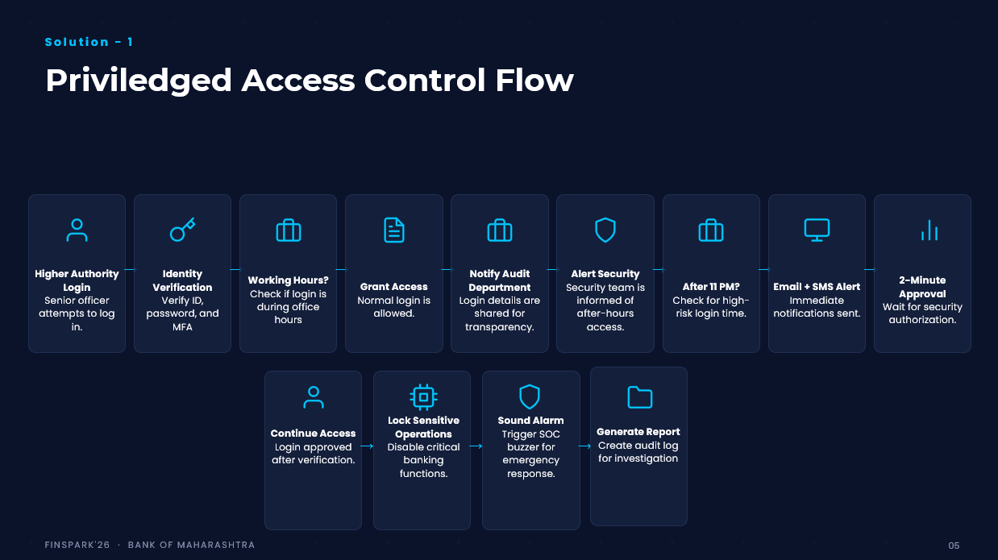

Slide 7






Solution 2
DURESS PASSWORD MECHANISM
3- Password Authentication
Login + Normal Emergency
Password
Covert Emergency Authentication enables employees under coercion to silently alert the Security Operations Center (SOC) while maintaining normal system behavior. This ensures rapid response without alerting the attacker.
Detects Coercion
Silent SOC Alert
Restricts Sensitive Actions
Strengthens Priviledge Access
FINSPARK'26 · BANK OF MAHARASHTRA
07

Slide 8
Competitive Advantage
Capability | Existing PAM | Existing UEBA | INSIGHT
Password Vault | ✓ | ✕ | ✓
Behaviour Analytics | ✕ | ✓ | ✓
Business Context Verification | ✕ | ✕ | ✓
Explainable AI | ✕ | ✕ | ✓
Duress / Coercion Authentication | ✕ | ✕ | ✓
Investigation Assistant | ✕ | ✕ | ✓
Human-Centric Decision Support | ✕ | ✕ | ✓
FINSPARK'26 · BANK OF MAHARASHTRA
08

Slide 9
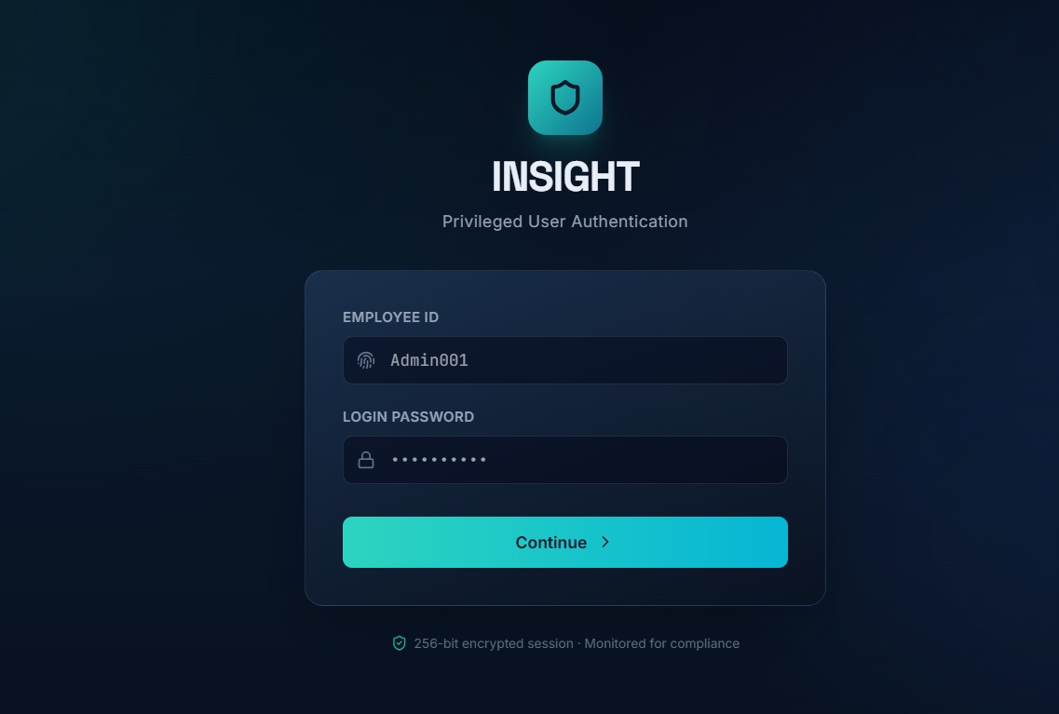
Prototype
FINSPARK'26 · BANK OF MAHARASHTRA
08

Slide 10
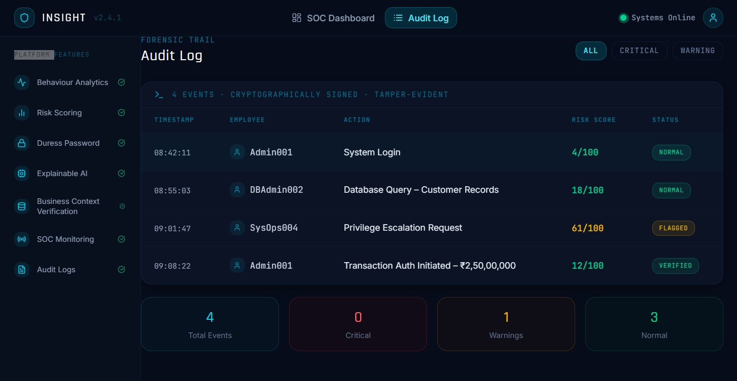
Prototype
FINSPARK'26 · BANK OF MAHARASHTRA
08

Slide 11
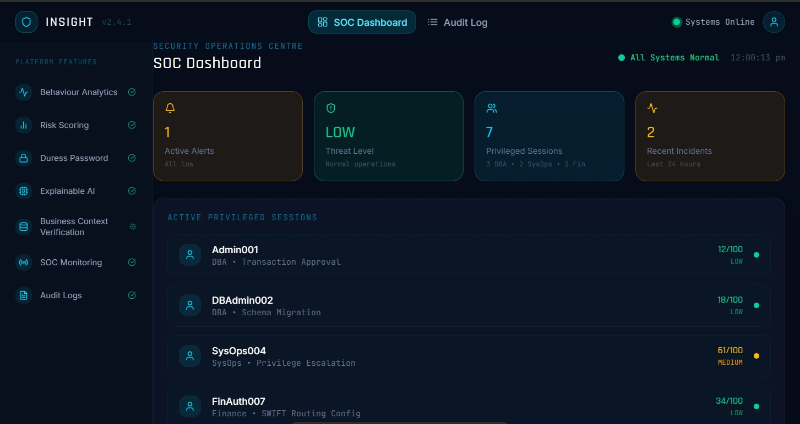
Prototype
FINSPARK'26 · BANK OF MAHARASHTRA
08

Slide 12
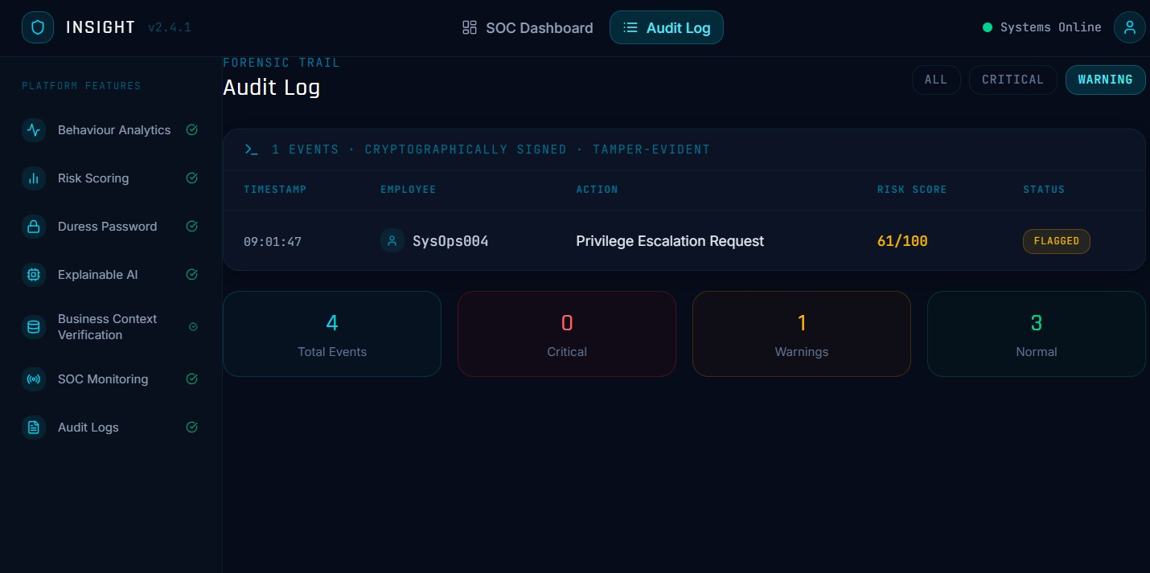
Prototype
FINSPARK'26 · BANK OF MAHARASHTRA
08

Slide 13



ROLLOUT
Scalability & Business Impact
National Deployment
Reduced Insider Risk
Head Office
Faster Investigation
Regional Office
Stronger Consumer Trust
Branch
Fewer False Positives
Better Decision Support
FINSPARK'26 · BANK OF MAHARASHTRA
09

Slide 14

WHAT'S NEXT
Building the Future of Trusted Banking
PHASE 1
PHASE 2
PHASE 3
PHASE 4
→
→
→
AI Investigation Assistant
Behaviour Intelligence
Collaborative Banking Security
Adaptive Risk Intelligence
FINSPARK'26 · BANK OF MAHARASHTRA
10

Slide 15
INSIGHT
Securing Trust Through Intelligent Insight.
Thank You
Drumi Jivani
Rishva Prajapati
Aditi Patel
Dhwani Shah
11

